Slide 1

Amazon Sales Analysis

Slide 2
Introduction
This project analyzes Amazon sales data using an interactive dashboard to understand sales performance, customer buying patterns, product trends, and regional sales distribution. The dashboard highlights key factors to support quick, data-driven business decisions and improve overall performance and customer satisfaction.

Slide 3
Objectives
Understand overall sales performance.
Identify top products & regions.
Analyze order and fulfillment patterns.
Highlight opportunities for improvement.

Slide 4
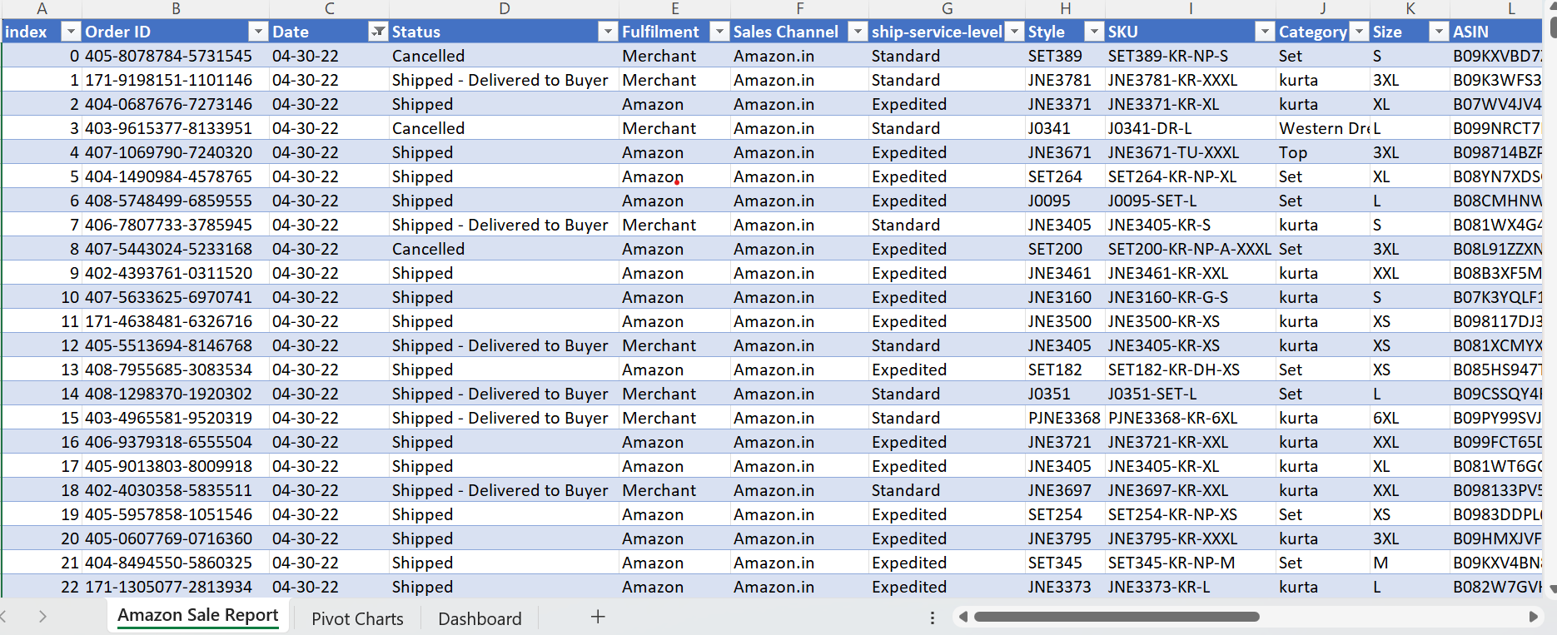
Table

Slide 5
Insights
Total sales is approximately ₹7.86 crore across 120K orders.
Major sales driven by Sets and Kurtas.
Maharashtra & Karnataka lead in sales.
Most orders successfully shipped.

Slide 6
Key Findings
Top category contributes majority of revenue.
Few states contribute large share of sales.
Cancellation rate around 14%.
Expedited shipping common for deliveries.

Slide 7
Recommendations
Focus marketing on top-performing categories.
Strengthen supply chain in high-demand states.
Investigate causes of order cancellations.
Promote fast delivery options to boost sales.

Slide 8
Conclusion
The sales dashboard analysis highlights strong business performance driven by key product categories and high-demand regions, while also revealing opportunities to improve fulfillment efficiency and reduce order cancellations. By focusing on top-performing segments, strengthening logistics operations, and using data-driven planning, the business can enhance customer satisfaction and sustain revenue growth. Overall, the dashboard serves as a valuable decision-support tool, enabling management to monitor performance trends and make informed strategic improvements.

